Slide 1


101 AWS – Deploying and Monitoring with Dynatrace
Andreas Grabner
DevOps Activist
Dynatrace
Safia Habib
Solutions Engineer
Dynatrace

Slide 2
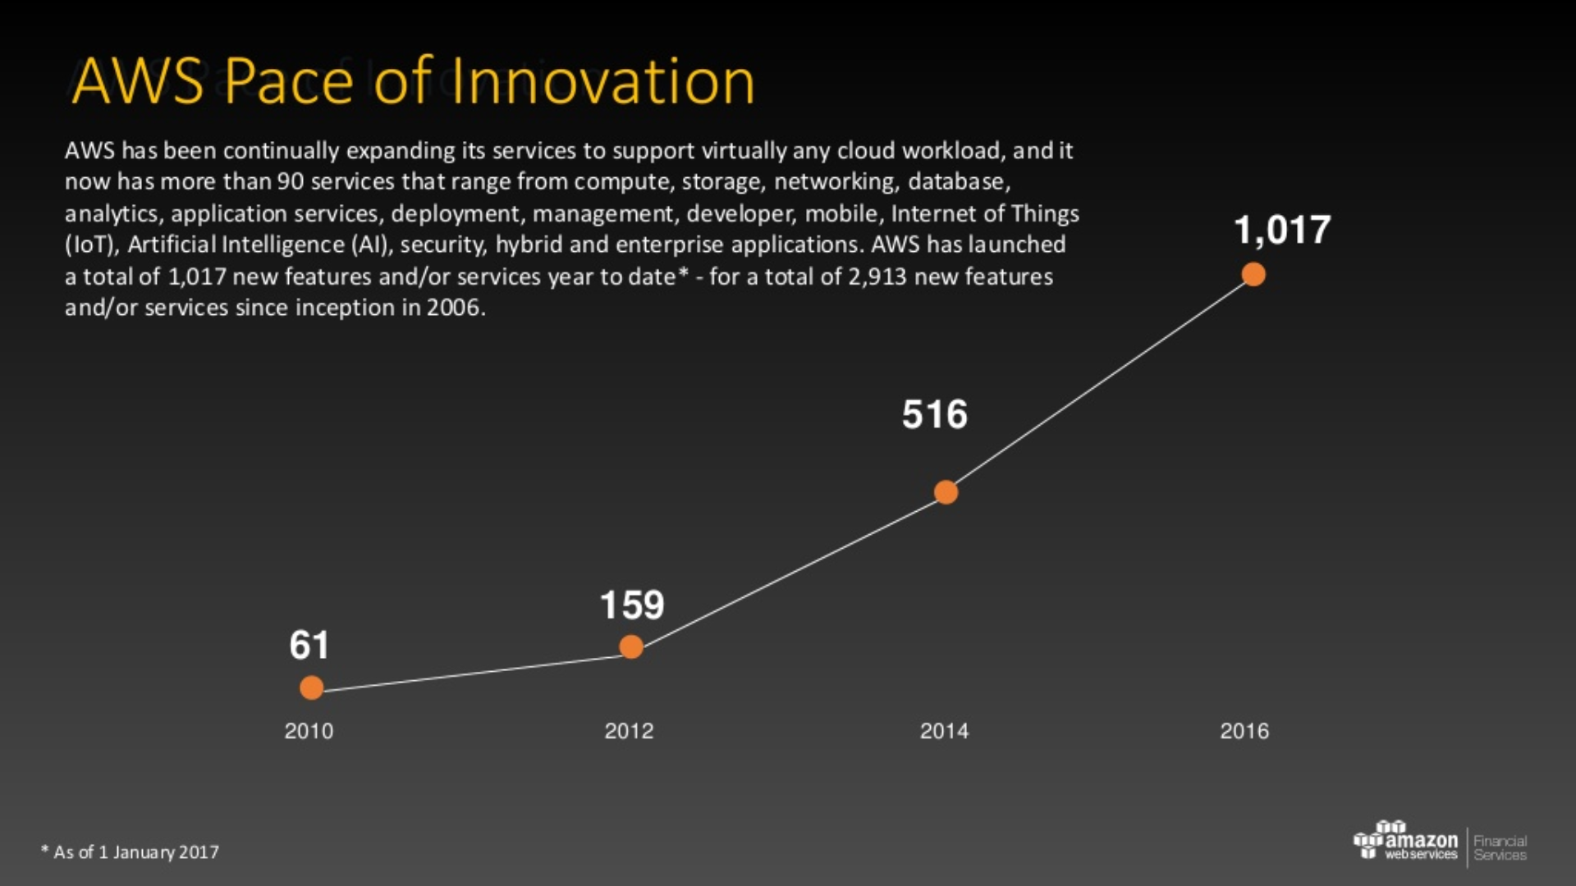

Slide 3




































































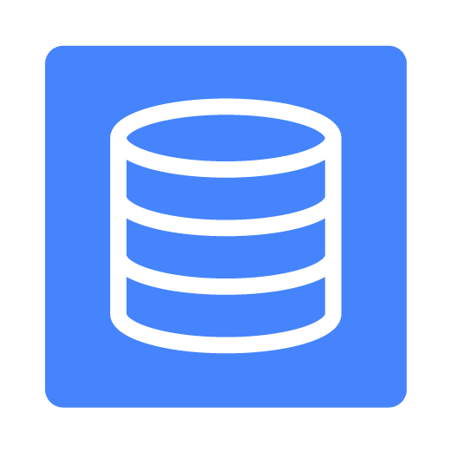





HYBRID ARCHITECTURE
MARKETPLACE
Business Apps
Business Intelligence
DevOps Tools
Security
Networking
Databases
Storage
Integrated Networking
TECHNICAL & BUSINESS SUPPORT
Support
Professional Services
Partner Ecosystem
Training & Certification
Solutions Architects
Account Management
Security & Billing Reports
Direct
Connect
ANALYTICS
APP SERVICES
MOBILE SERVICES
DEVELOPMENT & OPERATIONS
IoT
ENTERPRISE
APPS
GAMING
Data
Warehousing
Queuing & Notifications
API Gateway
One-click App Deployment
Rules Engine
3D Game Engine
Virtual Desktops
Business Intelligence
Single Integrated Console
DevOps Resource Management
Hadoop/Spark
Workflow
Device Shadows
Character Designer
Identity
Federation
Identity
Application Lifecycle Management
Sharing & Collaboration
Streaming Data Analysis
Search
Sync
Device SDKs
Multiplayer Service
Streaming Data Collection
Mobile
Analytics
Containers
Corporate Email
Email
Device Gateway
Cloud Integration
Integrated App Deployments
Machine Learning
Mobile App Testing
Triggers
Elastic Search
Transcoding
Push
Notifications
Resource Templates
Registry
Backup
Twitch Integration
Key Management & Storage
SECURITY & COMPLIANCE
Web application firewall
Data Backups
Identity Management
Access Control
Monitoring
& Logs
Configuration Compliance
Assessment and reporting
Resource & Usage Auditing
Compute
VMs, Auto-scaling, Load Balancing, Containers, Cloud functions
CORE SERVICES
Databases
Relational, NoSQL, Caching, Migration
Storage
Object, Blocks, File, Archives, Import/Export
CDN
Networking
VPC, DX, DNS
Integrated
Resource Management
INFRASTRUCTURE
Regions
Availability Zones
Points of Presence

Slide 4
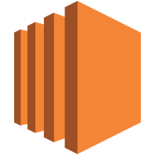



Compute
EC2
Auto Scaling
Lambda
EC2 Container Service
Elastic Beanstalk

Slide 5
Compute
Elastic Compute Cloud (EC2)
Virtual Servers in the Cloud
Resizable Compute Capacity
Complete control of your computing resources
Reduces time to obtain and boot new server instances to minutes
Choose from 30+ different instance types
Scale as your requirements change
Pay only for what you use
Or reserve instances for a committed discount

Slide 6
Compute
Auto Scaling
Scale your infrastructure automatically
Adds or removes EC2 instances based on metrics and health checks
No additional charge
Minimize cost and maximize performance
Integrates with Elastic Load Balancers

Slide 7
Compute
Lambda
Run Code in Response to Events
Runs code in response to triggers such as S3 upload, DynamoDB updates, Kinesis streams, and API Gateway requests
Automatically scales
You only need to provide the code; there is no infrastructure to manage
Pay only for what you use

Slide 8
Compute
EC2 Container Service (ECS)
Run and Manage Docker Containers
A high performance container management service for running Docker containers on EC2 instances
Use the built in scheduler, write your own, or use a third-party scheduler
Integrates with other services like ELB and EBS
No additional charge
Container Registry

Slide 9
Compute
Elastic Beanstalk
Run and Manage Web Apps
Ideal for developers that simply want to upload their code and have the service manage the rest
Supports Docker, Java, .NET, Node.js, PHP, Python, Ruby, and Go
Automatically handles deployment, load balancing, auto-scaling, and application health monitoring
Retain full control over the AWS resources powering your application

Slide 10



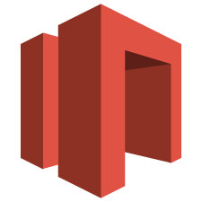

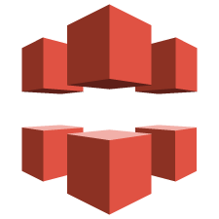
Storage & Content Delivery
EC2
Glacier
EBS
Storage Gateway
Import/Export
CloudFront

Slide 11
Storage & Content Delivery
Simple Storage Service (S3)
Scalable Storage in the Cloud
Storage for the Internet
Store and retrieve any amount of data, at anytime, from anywhere on the web
Highly scalable, reliable, and secure
Supports encryption
Pay only for what you use
Can be used in conjunction with CloudFront to serve up a single page app without a Web Server

Slide 12
Storage & Content Delivery
CloudFront
Global Content Delivery Network
Distribute content with low latency, high transfer speeds, and no commitments
>60 edge locations
Simple integration with AWS services
Static and dynamic content
Advanced CDN features like SSL support, geographic restriction, and private content

Slide 13
Storage & Content Delivery
Glacier
Archive Storage in the Cloud
Low cost storage for archiving and backup
Secure and durable
No limit to amount of data stored
Flexible
Pay only for what you use
Simple integration with S3

Slide 14
Storage & Content Delivery
Elastic Block Store (EBS)
Block Storage for EC2
Persistent off-instance storage
SSD or magnetic disk
Durable snapshots to S3
Encryption support

Slide 15
Storage & Content Delivery
Storage Gateway
Integrates On-Premises IT Environments with Cloud Storage
Delivered as a virtual machine installed in an on-premises datacenter
Integration with S3, EBS, and Glacier
Secure data transmissions between AWS and on-premise resources
Compatible with on-premise storage solutions through iSCSI interface.

Slide 16
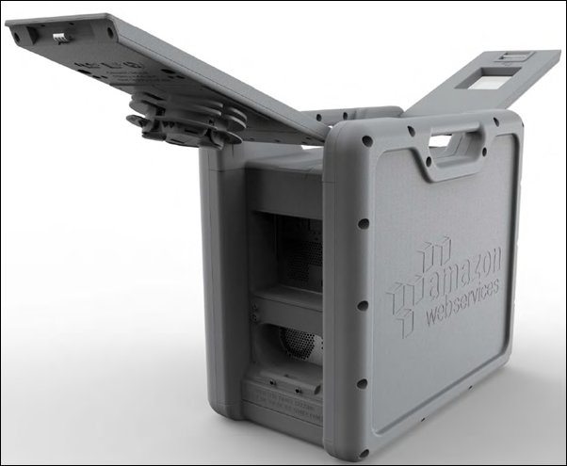
Storage & Content Delivery
Import/Export Options
Large Volume Data Transfer
Direct Connect: a dedicated virtual network from your location to ours
Import/Export Disk: ship your physical disks to AWS
Import/Export Snowball: ship petabytes of data to AWS using our secure appliance
Snowmobile

Slide 17
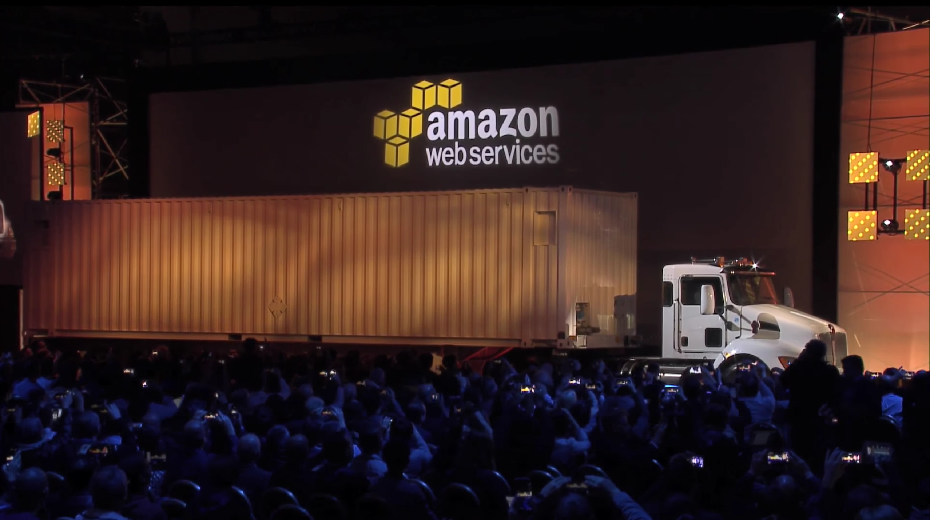

Slide 18


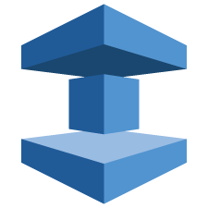

Database
RDS
DynamoDB
ElastiCache
Redshift
Aurora

Slide 19
Database
Relational Database Service (RDS)
Managed Relational Databases
Resizable capacity
Handles time-consuming administration tasks
Multiple engine types available
High durability options
Automatic patching and backups

Slide 20
Database
DynamoDB
Predictable and Scalable NoSQL Data Store
Fast, fully-managed NoSQL Database Service
Capable of handling any amount of data
Durable and Highly Available
All SSD storage
Simple and Cost Effective

Slide 21
Database
Aurora
Relational Database Engine
Relational database built for the cloud
Highly available, durable, and scalable
Up to 64 TB database size, 15 read replicas
Highly secure
MySQL-compatible

Slide 22
Database
ElastiCache
In-Memory Cache
Managed cache service
Supports Memcached or Redis
Simple resizing through API or console
Integrates with Cloudwatch and SNS

Slide 23
Database
Redshift
Fast, simple, cost-effective data warehousing
Fully managed SQL-based data warehouse
Massively parallel, petabyte scale
As low as $1,000/TB/Year
Online and functional in minutes
ODBC/JDBC Compliant
Continuous backup

Slide 24
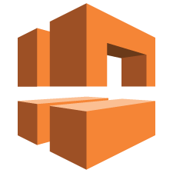



Networking
VPC
ELB
Route 53
Direct Connect

Slide 25
Networking
Virtual Private Cloud (VPC)
Isolated Cloud Resources
Create user-defined virtual networks
Allows control of the networking environment
Can be connected to existing datacenters over VPN or Direct Connect
Can be peered with other VPCs in AWS

Slide 26
Networking
Route 53
Scalable DNS and Domain Name Registration
Answers DNS queries with low latency by using a global network of DNS servers
Latency based routing to closest AWS endpoint
Integration with other AWS services
Register domain names

Slide 27
Networking
Elastic Load Balancing (ELB)
Application Load Balancing
Supports load balancing of HTTP, HTTPS, and TCP traffic to EC2 instances
Detects and removes failing instances
Dynamically grows and shrinks based on traffic
Integrates with Auto Scaling

Slide 28
Networking
Direct Connect
Dedicated Network Connection to AWS
Establish a dedicated network connection from your premises to AWS
Reduces bandwidth costs for high-volume data transfers
Offers consistent network performance
Speeds from 50 Mbps to 10 Gbps per port

Slide 29







Application Services
SES
SNS
SQS
API
Gateway
CloudSearch
Elastic Transcoder
Simple Workflow Service

Slide 30
Application Services
Simple Email Service (SES)
Email Sending Service
Bulk and transactional email-sending service
Eliminates email server management
Meet rigorous Internet Service Provider (ISP) standards
Built-in feedback loop on successful and unsuccessful messages

Slide 31
Application Services
CloudSearch
Managed Search Service
Integrate fast and highly scalable search functionality into applications
Scales automatically
AWS manages hardware provisioning, data partitioning, and software patches

Slide 32
Application Services
Simple Notification Service (SNS)
Push Notification Service
Set up, operate, and send notifications
Publish messages from an application and immediately deliver them to subscribers or other applications
Push messages to mobile devices

Slide 33
Application Services
Elastic Transcoder
Easy-to-use Scalable Media Transcoder
Converts media files between formats
Highly scalable
Integration with S3 and CloudFront

Slide 34
Application Services
Simple Queue Service (SQS)
Message Queue Service
Managed and scalable message queue
Building block for distributed systems
Highly available and durable
Pay for what you use

Slide 35
Application Services
Simple Workflow Service
Workflow Service for Coordinating Application Components
Coordinate processing steps across distributed systems
Manages workflows, including state, decisions, executions, tasks, and logging
Ensure tasks are executed reliably, in order, and without duplication
Simple API calls can be executed from code written in any language

Slide 36
Application Services
API Gateway
Build, Publish and Manage APIs
Performance at any scale via worldwide edge locations, traffic throttling, and API output caching
Monitor API activity
Integrates with Lambda functions
Run multiple versions of the same API
Fully Managed

Slide 37






Administration & Security
Directory Service
IAM
Trusted Advisor
CloudTrail
Key Management Service
CloudWatch
AWS Config
Service Catalog
CloudHSM
Certificate Manager

Slide 38
Administration & Security
CloudWatch
Resource and Application Monitoring
Visibility into resource utilization and operational performance with Metrics and Logs
Set alarm thresholds to send notifications or trigger Auto Scaling
Log aggregation, monitoring, and troubleshooting with CloudWatch Logs
Support for customer-published measurements with Custom Metrics

Slide 39





Developer & Management
CodeDeploy
CodePipeline
CodeCommit
OpsWorks
CloudFormation
Application Discovery

Slide 40
Developer & Management
CloudFormation
Create and Manage Resources with Templates
Model, provision, and update AWS resources through JSON formatted text files
Deploy stack from template with runtime parameters
Visualize and make quick edits to templates with CloudFormation Designer’s drag-and-drop interface
Repeatable, reliable provisioning

Slide 41




Analytics
EMR
Kinesis
Data Pipeline
Machine Learning
QuickSight
Elasticsearch Service

Slide 42
Analytics
Elastic MapReduce (EMR)
Managed Hadoop Framework for Big Data Processing
Elastic cluster sizing based on workflow demands
Batch and real-time processing
Long-running or transient clusters
Spot instance support for cost optimization
Easy integration with AWS datastores

Slide 43
Analytics
Kinesis
Work with Real-time Streaming Data
A platform for streaming data on AWS, currently consists of:
Kinesis Firehose
Kinesis Streams
Load streaming data into S3 and Redshift
Build custom, real-time applications
Zero on-going administration
Direct-to-data store integration
Easy administration
Low cost

Slide 44
Monitoring AWS with Dynatrace

Slide 45
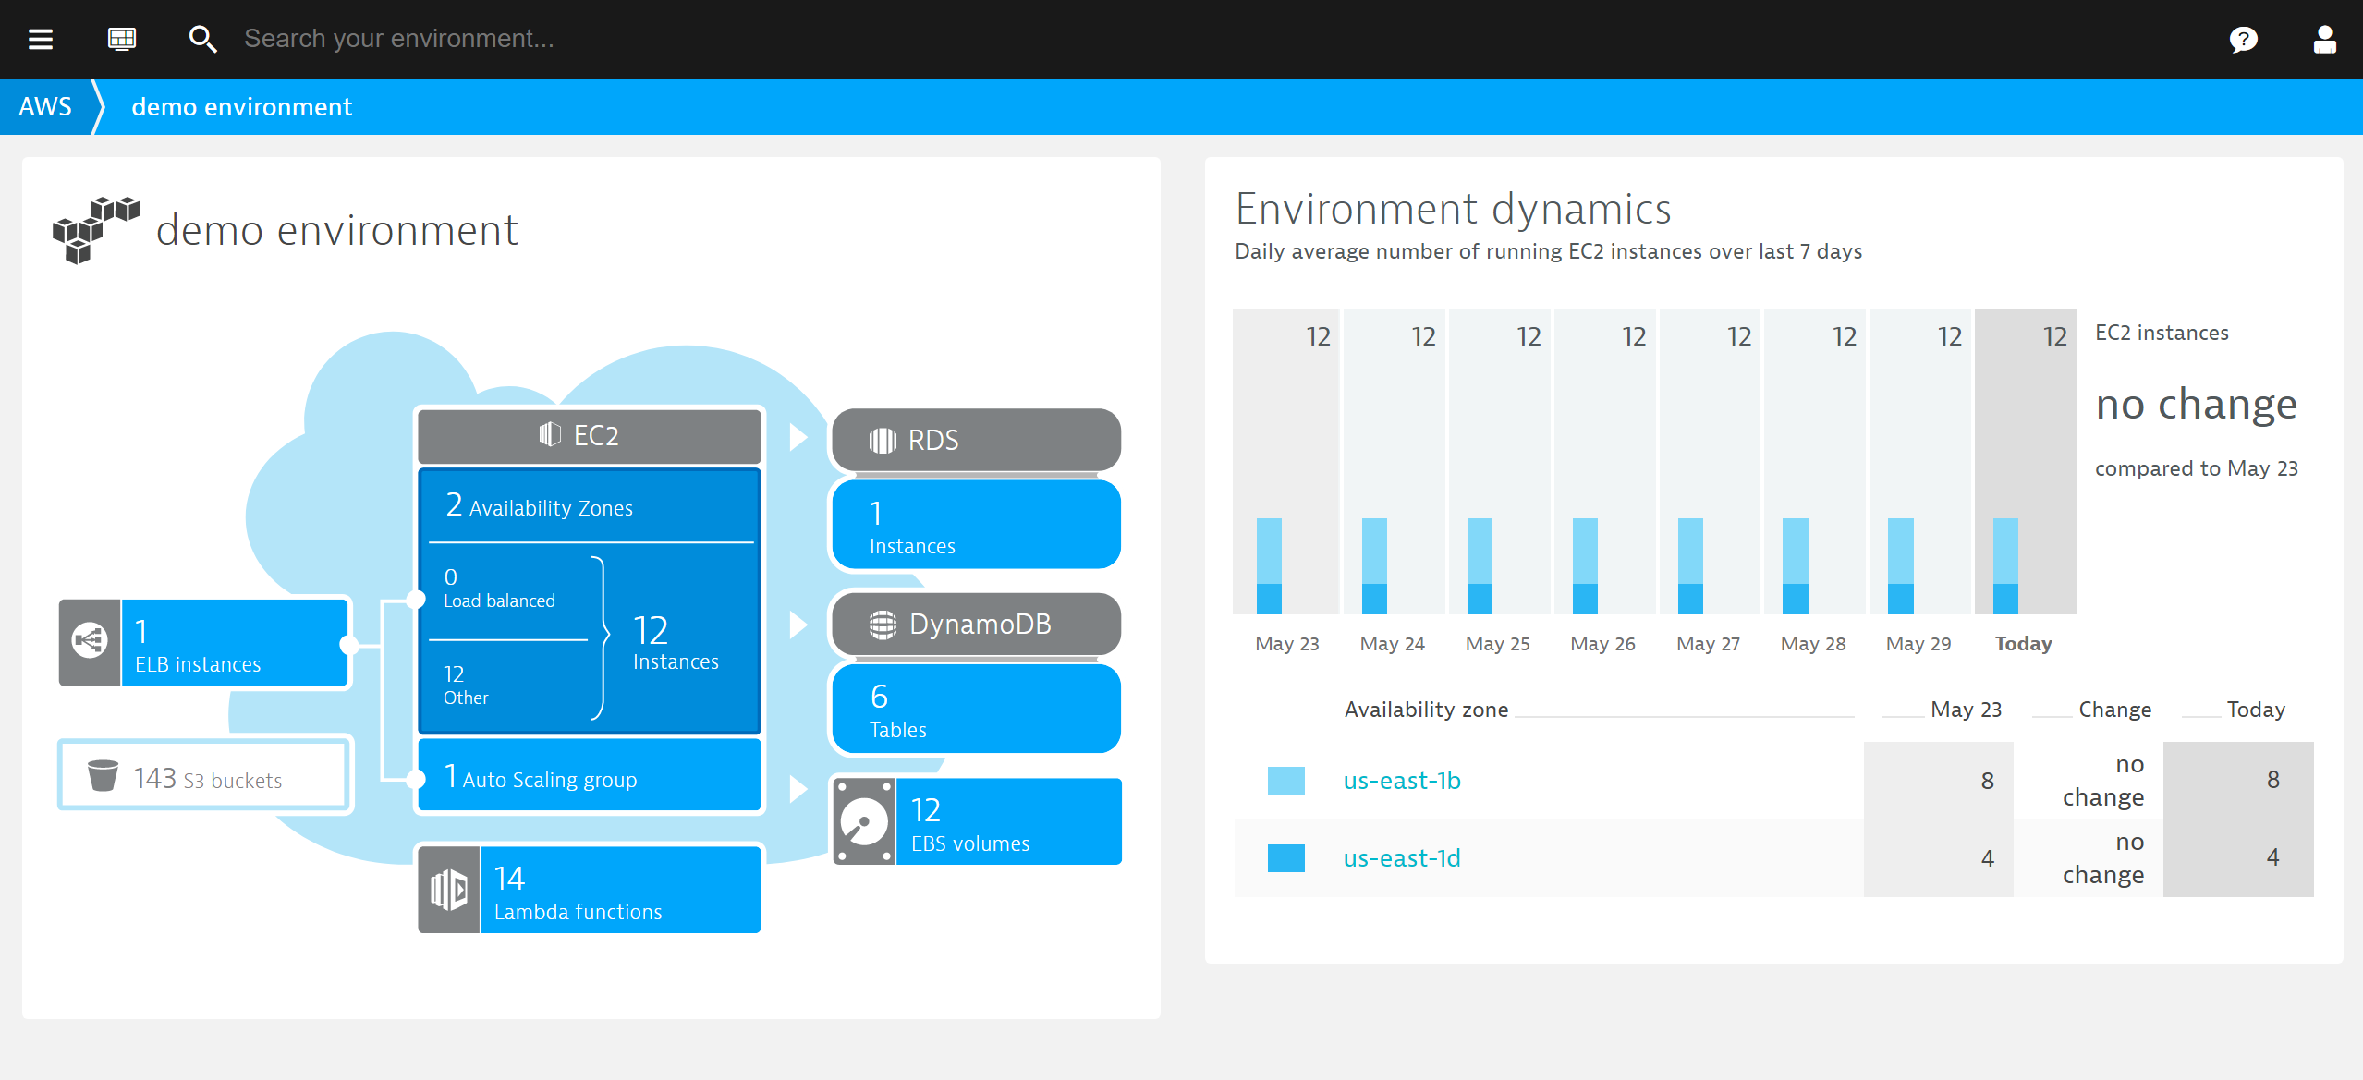

Slide 46
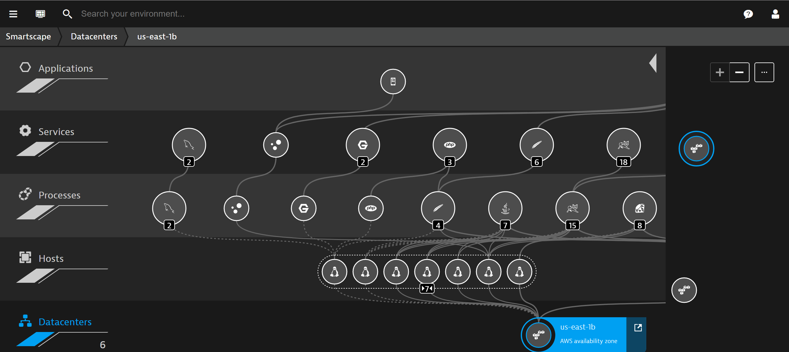

Slide 47
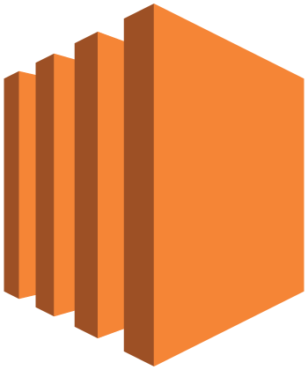

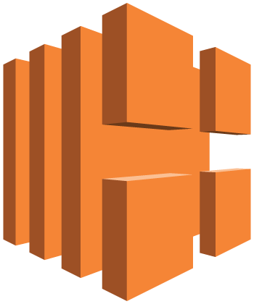


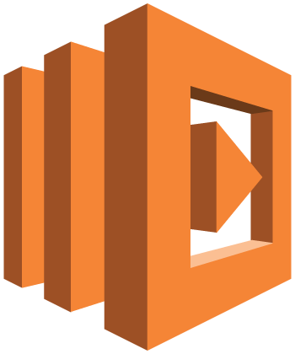




Dynatrace currently supports the following Amazon Web Services:
Amazon EC2
Amazon EBS
Elastic Load Balancing
Simple Storage Service
Auto Scaling
Relational Database Service
Amazon DynamoDB
AWS Lambda
AWS Elastic Beanstalk

Slide 48
How do we monitor AWS?

Slide 49

Amazon CloudWatch

Slide 50
Amazon CloudWatch
is a monitoring service for AWS cloud resources and the applications you run on AWS. You can use Amazon CloudWatch to collect and track metrics, collect and monitor log files, set alarms, and automatically react to changes in your AWS resources.

Slide 51
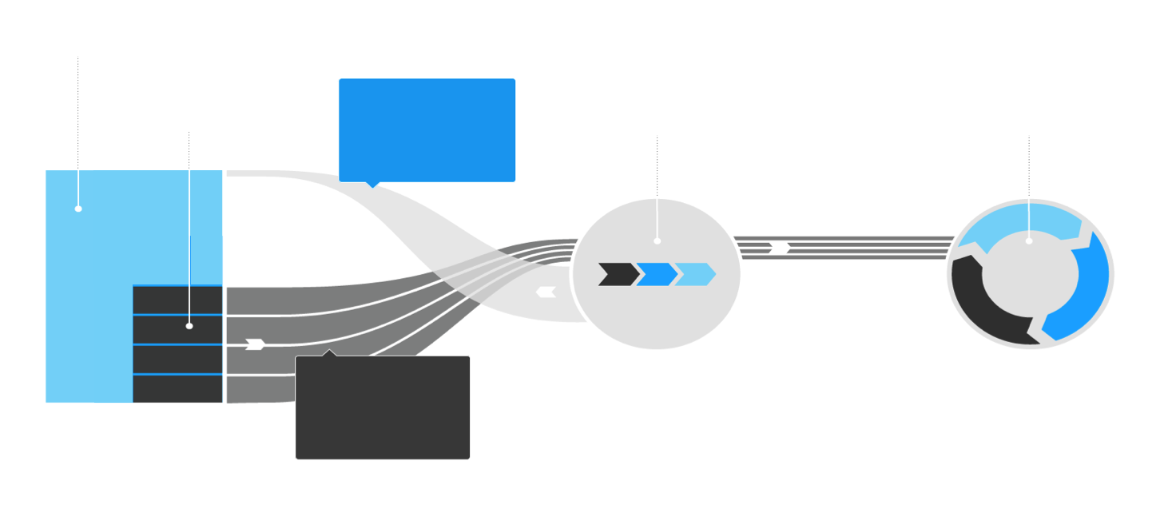
Collect the CloudWatch API metrics and send them to the Dynatrace Server
CloudWatch API
(EC2,ELB, RDS, S3, EBS, Lambda, DynamoDB, Auto scaling group )
SGW queries CloudWatch API every 5 minutes for
metrics
Host (EC2)
Public Security GW
Dynatrace Server
Agent sends metrics
every min

Slide 52

Extend the CloudWatch Visibility with Full Stack Monitoring
Application
Data
Runtime
Operating System
Virtualization
Machines
Amazon
CloudWatch
Storage
Dynatrace
Full Stack
Monitoring
Network

Slide 53
Let’s Start Monitoring AWS

Slide 54
Tutorial Overview
Full Tutorial and description on GitHub
https://github.com/safia-habib/AWSMonitoringTutorials
We plan to implement 4 labs from the tutorials for today’s HOT Day session
Lab 2(a): Monitoring EC2 instance with inbuilt Application
Lab 1: Setting up AWS Monitoring through Cloud Watch Integration
Lab 3: Monitoring NodeJS deployed through Elastic Beanstalk
Lab 8: Monitoring AWS Lambda Functions
Bonus (If time permits)
Lab 5: AWS ECS Monitoring

Slide 55
Pre-requisites: https://github.com/safia-habib/AWSMonitoringTutorials
Dynatrace SaaS tenant – as provided during the class
AWS Account with administrative privileges
For Troubleshooting
Create a Key Pair for EC2.
Download your key.pem
More instructions to Connect to EC2 via Linux (SSH), Windows (PuTTy): https://docs.aws.amazon.com/AWSEC2/latest/UserGuide/AccessingInstances.html

Slide 56
AWS Hands-on 1
Goals: Deploying EC2 Instance with a Dynatrace OneAgent

Slide 57
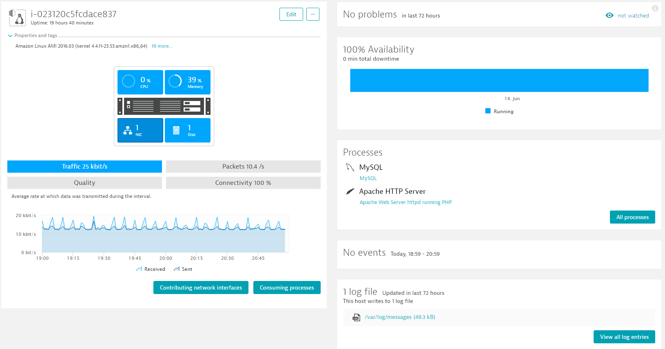
Goal: See EC2 Host Monitored by Dynatrace
Steps
Lab 2(a) : Monitoring EC2 instance with Inbuilt application
Find the AMI from Community AMI’s : Dynatrace_Easytravel_Docker_EC2
Add UserData which is a “Startup Script” executed when launching EC2 Instance
#!/bin/bash
wget -O Dynatrace-OneAgent-Linux.sh https://YOUR.FULL.DYNATRACE.ONEAGENT.DOWNLOADLINK
/bin/sh Dynatrace-OneAgnt-Linux.sh APP_LOG_CONTENT_ACCESS=1 INFRA_ONLY=0
chown ec2-user:ec2-user /home/ec2-user/easyTravel-Docker/docker-compose.yml
/usr/local/bin/docker-compose -f /home/ec2-user/easyTravel-Docker/docker-compose.yml up -d

Slide 58
AWS Hands-on 2
Goals: Setup Dynatrace AWS Monitoring Integration

Slide 59
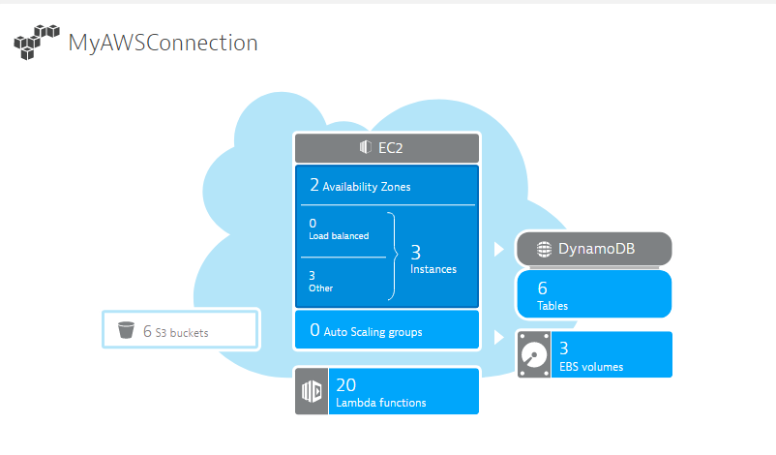
Goal: See AWS CloudWatch Data in Dynatrace
Steps
https://github.com/Dynatrace/AWSMonitoringTutorials#lab-1-setup-dyntrace-aws-monitoring-integration
Approach: Access Cloud Watch
via Access Key-based Authentication or
via Role-based Authentication

Slide 60
AWS Hands-on 3
Goals: AWS Nodejs application with Elastic Beanstalk

Slide 61
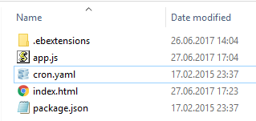
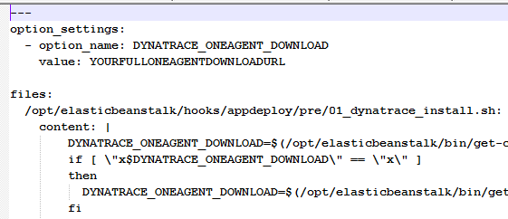
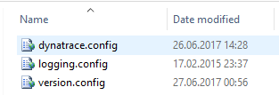
101 on BeanStalk
What is Beanstalk?
AWS Hosts and Scales Application Servers (Node.JS, Java, …) for you
Developer only provides ZIP or WAR file
ZIP/WAR File gets deployed on Application Server during startup
Automatically Load Balanced / Auto-Scaling …
Beanstalk ZIP File Structure

Slide 62
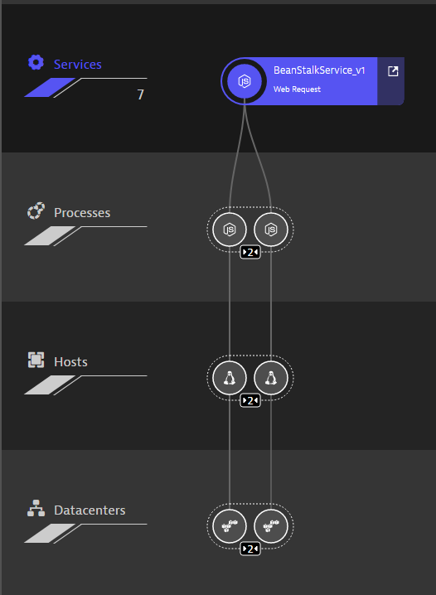
Goal: See Full-Stack Tracing of Node.JS Beanstalk Application
Steps
https://github.com/Dynatrace/AWSMonitoringTutorials#lab-3-monitor-nodejs-beanstalk-application
Using .ebextension mechanism to
Execute Agent Download and Install during EC2 Launch
Pass additional tags, e.g: BeanStalkVersion_v2
Additional Hands-On Use Cases
Custom Process Group Identification, e.g: BeanStalkVersion_v2
Load Balancing / Auto-Scaling BeanStalk Service
RUM Configuration: User Tagging and jQuery Support
Configure Request Attributes
Known Issues
On Mac: make sure .zip file contains .ebextension folder!

Slide 63
AWS Hands-on 4
Goals: AWS Lambda Monitoring

Slide 64
Goal: Monitoring AWS Lambda Functions
Steps
https://github.com/safia-habib/AWSMonitoringTutorials/blob/master/README.md#lab-8-monitoring-aws-lambda-functions
Background on Sample application
Simple Nodejs application to make http requests to multiple websites
Additional Steps
Integrate the Dynatrace OneAgent with Lambda function
Manual Inject for Real-user Monitoring in S3 stored index.html

Slide 65
Additional steps
To View the data on the Dynatrace Portal use the following Dynatrace environment
Dynatrace Environment: https://evx56386.live.dynatrace.com/
Username: students_aws101@dynatracelabs.com
Password: Dyn@trac3
Environment Variable:
DT_NODE_OPTIONS: {"dynatraceTagPropertyPath": "event.params.header.x-dynatrace","server": "https://evx56386.live.dynatrace.com:443", "tenant": "evx56386", "tenanttoken": "550PjokLKGn4fjFC", "loglevelcon": "info"}

